Slide 1

Sales Performance Report
An In-depth Analysis of Sales Data
Made by- Shubham Prakash

Slide 2

1. Overview
This report provides an in-depth analysis of the sales performance across categories, products, and salespersons. Insights are derived from gender-specific dashboards, comparing male and female sales data.

Slide 3

2. Total Sales Overview
• Total Units Sold: 283K
• Best Performer: Robert Simpson

Slide 4

3. Category-Wise Sales Performance
• Clothing: 48.16% (USD 135.18bn)
• Home & Kitchen: 38.18% (USD 107.15bn)
• Electronics: 13.66% (USD 38.35bn)
Recommendation: Focus on Clothing, explore growth in Home & Kitchen, boost Electronics via promotions.

Slide 5

4. Salesperson Performance
• Best Performer: Robert Simpson
• Consistent Performers: Christopher Davis, Ronald Bates
• Areas for Improvement: Douglas Allen, Kevin Hansen
Recommendation: Analyze top sales strategies and train lower performers.

Slide 6

5. Product-Wise Performance
• Top-Selling Products: Wallets, Mixing Bowl, and Goggles.
• High-Revenue Products: Women's Shirts, Walki, Wallets
• Niche Appeal: Wall Clocks, Walkie Talkies
Recommendation: Stock high-demand products, market underperformers strategically.

Slide 7
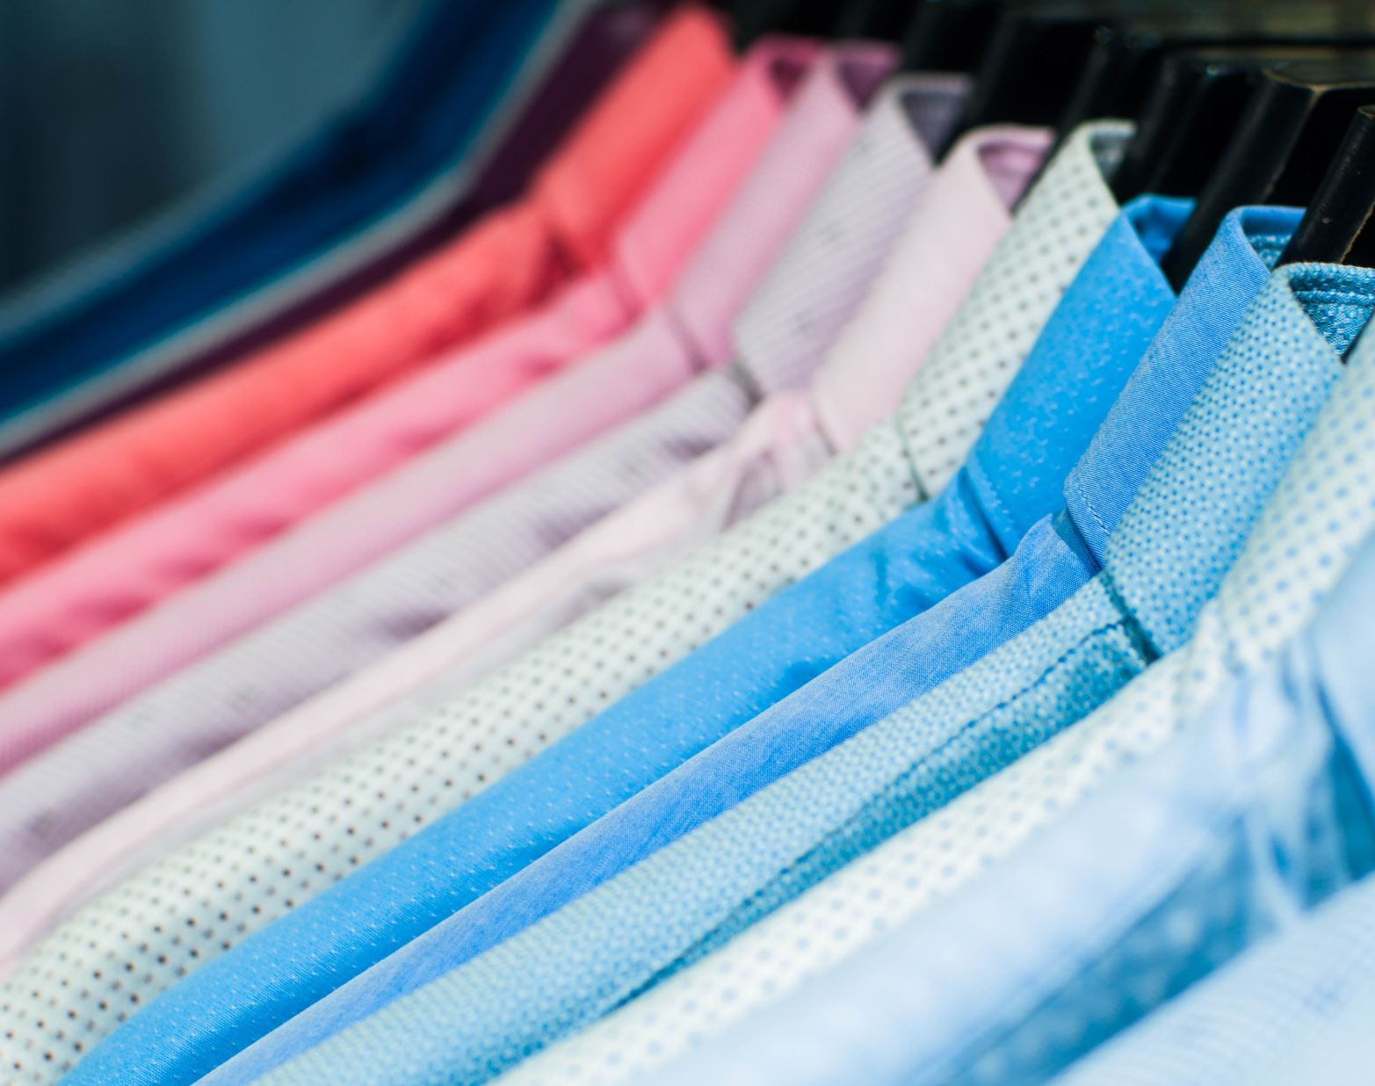
6. Gender-Based Insights
• Males excel in Clothing sales, especially Women’s Shirts & Waist Tops.
• Females show balanced sales, favoring Home & Kitchen.
Recommendation: Personalize marketing.

Slide 8

7. Key Takeaways
• Leverage High Performers: Train using Robert Simpson’s strategies.
• Category Growth: Electronics is an untapped market.
• Product Promotion: Use targeted campaigns for high-revenue items.
• Sales Training: Improve underperformers through development programs.

